Slide 1

TEAM NO: 5
TOPIC : TRAVEL ITINERARY OPTIMIZER
PRESENTED BY:
A.VENNELA REDDY – 25MVCSMR0002
B.LOHITHA REDDY – 25MVCSMR0012
C.MEGHANA – 25MVCSMR0027
Y.LAKSHMI SRI – 25MVCSMR0093

Slide 2

TRAVEL ITINERARY OPTIMIZER:
MINIMIZING COST
UNDER TIME CONSTRAINTS
Optimizing multi-city travel routes to reduce cost within a maximum trip duration.
TEAM MEMBERS
PROBLEM DOMAIN
Alice
Bob
Charlie
Travel planning
Route optimization
Logistics

Slide 3


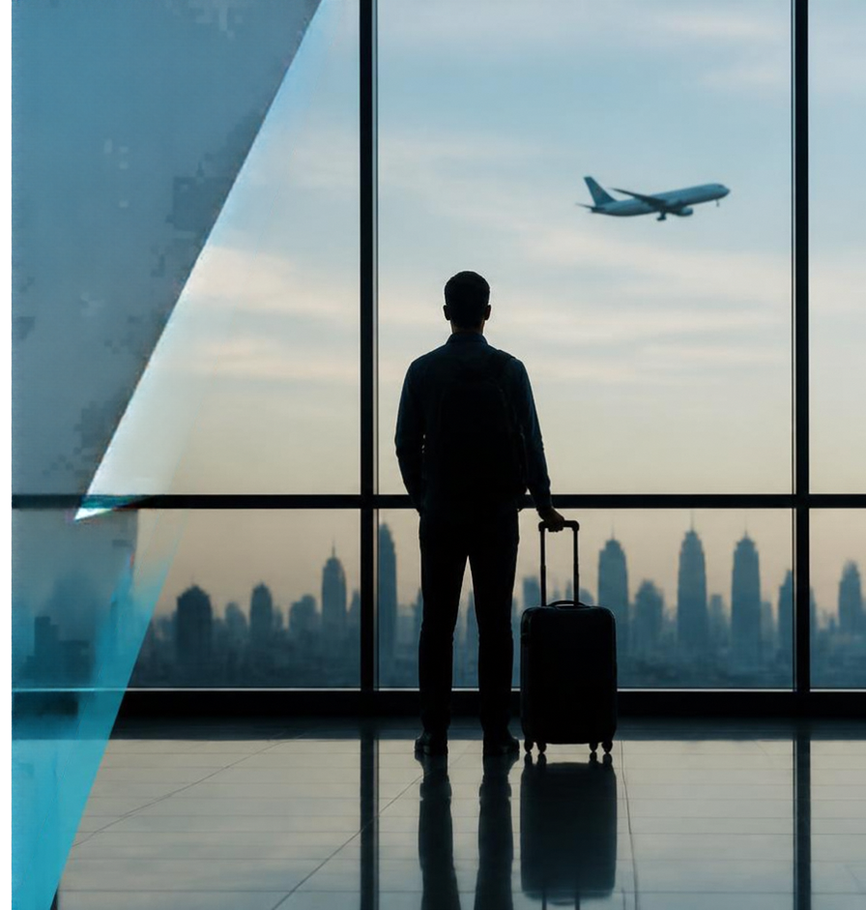
THE
CHALLENGE
Planning efficient multi-city trips that save both cost and time.
KEY CHALLENGES
Balancing cost minimization with trip duration limits
Handling combinatorial explosion of possible routes
Avoiding repeated visits and unnecessary detours

Slide 4










OUR
3
INNOVATION
4
A smarter way to plan multi-city trips that balances cost, time, and clarity.
TSP
2
Smarter optimization
global route model
Minimizes travel cost while respecting maximum trip duration
5
Dynamic Programming
Complete visibility
efficient subproblem solving
Shows the best route with visit order so every decision is clear
Branch and Bound
Faster results
prunes unpromising paths
Uses intelligent bounds to prune the search space
1
One integrated approach. Balanced speed and accuracy.

Slide 5











HOW
IT WORKS
01
02
03
04
INPUT
PROCESSING
ALGORITHM
OUTPUT
User enters cities,
max trip duration,
and travel costs
Data structured as graph with distances and constraints
TSP modeled problem solved via Dynamic Programming and Branch and Bound
Optimized itinerary with visit sequence, cost, and duration displayed
USER
JOURNEY
Input
Optimization
Visual route
Decision support
Provide trip
details
Run algorithm to find
best route
See optimized
itinerary map
Make smarter travel decisions

Slide 6








TECHNOLOGY & ALGORITHM
The right stack and algorithms to find better multi-city itineraries.
TECH STACK
ALGORITHM APPROACH
WHY THIS APPROACH
Traveling Salesperson
Problem (TSP)
formulation for route sequencing
Rapid development
Python enables fast prototyping
with rich libraries
Python
algorithms and
data processing
1
BACKEND
Seamless experience
React delivers a responsive
and interactive interface
React
interactive
user interface
Dynamic Programming
solves overlapping subproblems
efficiently
FRONTEND
2
Lightweight and efficient
Flask keeps backend services
simple and reliable
Flask
communication between
frontend and backend
Branch and Bound
prunes non-promising routes
to reduce computation
TSP is NP-hard
Dynamic Programming and
Branch and Bound are used to
manage complexity in practice.
API
3

Slide 7




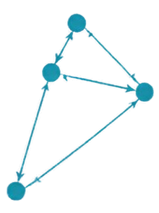





DEMO & IMPACT
See the optimizer in action and the value it delivers.
Plan Your Trip
Optimized Route Map
Itinerary Output
Cities
Constraints
Delhi
Visit Order
City
Cost (₹)
Duration
Mumbai
Delhi
Jaipur
Agra
Mumbai
Trip Duration (itbsi)
1
Mumbai
–
–
5
Jaipur
Jaipur
Budget (€)
2
Delhi
3,200
1d
15000
Agra
3
Jaipur
2,800
1d
Start City
4
Agra
2,000
1d
Mumbai
5
Mumbai
4,500
1d
Mumbai
Total
12,500
5 days
Optimize itinerary
1. Input your cities and constraints
2. View optimized itinerary on map
3. Review order, cost, and duration
PERFORMANCE HIGHLIGHTS
SAMPLE OUTPUT
PRACTICAL BENEFITS
Branch and Bound pruning reduced
search space by ~60%
Mumbai → Delhi → Jaipur → Agra → Mumbai
Saves travel cost and time
Enhances trip planning confidence
DP stored subresults to
avoid recomputation
Total cost: ₹12,500 | Duration: 5 days
Scalable to moderate city counts (5-15)

Slide 8
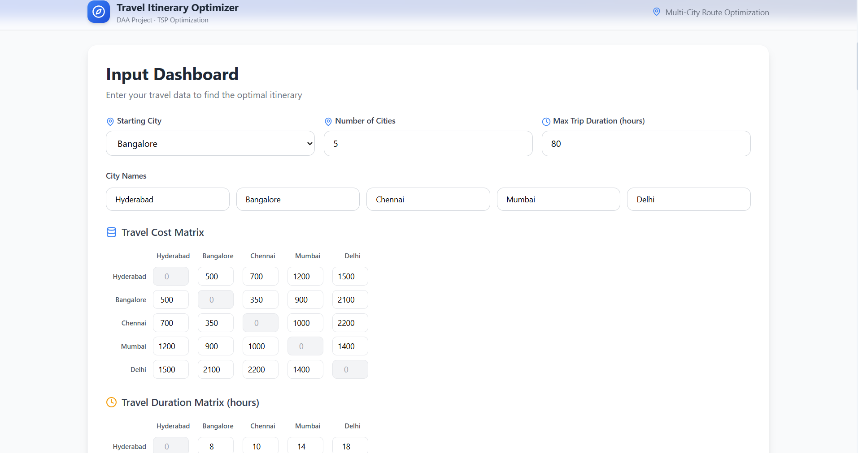
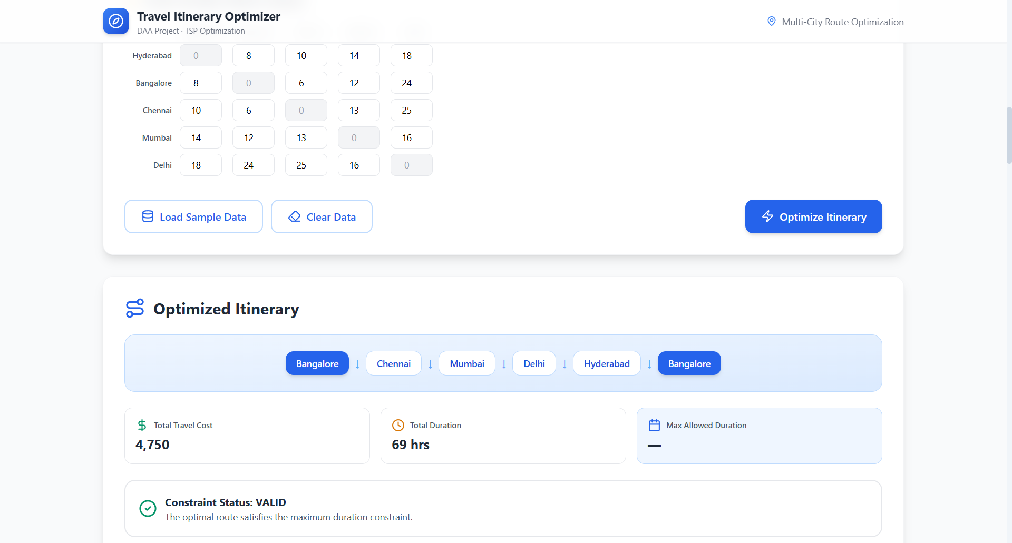

Slide 9
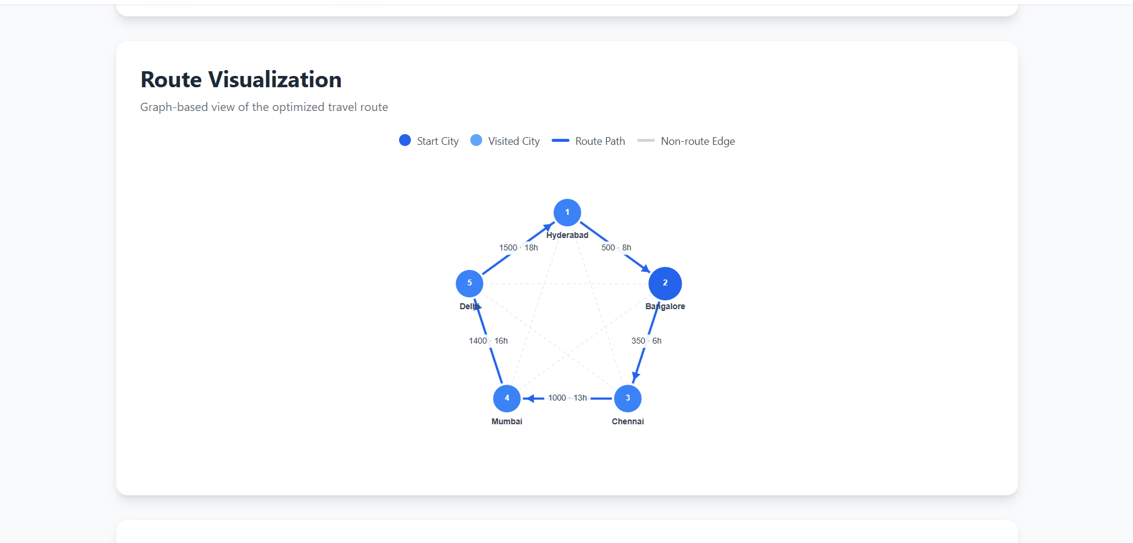

Slide 10



FUTURE VISION &
THANK YOU
Current achievement: functional prototype
integrating algorithms and UI
Future improvements: real-time data,
multi-modal transport, and smarter algorithms
Scalability: built to optimize larger city sets
with hybrid approaches
Our promise: a smart, user-friendly tool to plan cost-efficient trips under time constraints
THANK YOU!
QUESTIONS AND FEEDBACK WELCOME.
team@hackathon.com

